Slide 1
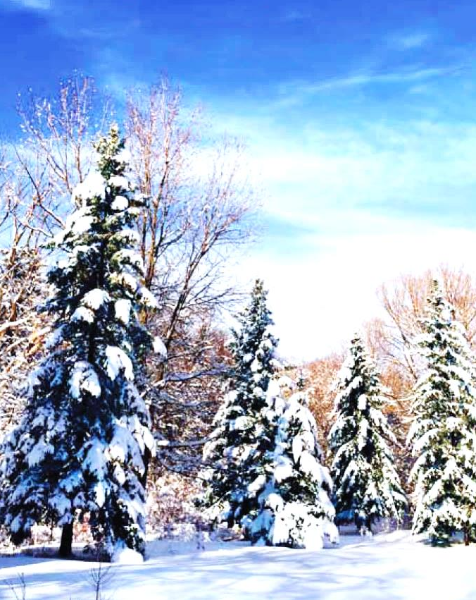
CBCGL FAMILY NEWS
WELCOME TO
CBCGL English Ministry
Praise the Lord! We have collected a combined pledge of $2,950.00 last Sunday and reached a total of $1,892,195.00 to date. Please continue to pray for and participate to pledge for the equipment expenditure, ask God’s blessing that we can move on to Phase II quickly after the completion of Phase I. Please issue the check to "CBCGL" with "Building Project" on the memo line for your donation.
LYF Winter Teen Conference 2016 for high school and junior high school will hold separately on Feb 12-15 and Feb 26-28. Registration deadline is Jan 10 (today). We are also looking for adult counselors for the conference. If you're interested, please contact Pastor Willems, sister Vivian Gillis or brother Tony Ge
Youth ministry will send two short term mission teams to serve in Costa Rica and for Boston Project this summer. The first fundraising event hosted by YMC is to sell NianGao (Chinese Rice Cake) for the Chinese New Year. Please contact Sophia Wong, Vivian Gillis, Grace Zhou or Tony Ge if you are interested and indicate your choice of flavors: red bean or brown sugar, $10 each.
Seeking to Transform Lives and Communities
- Opportunities and Actions, John 9:4
FOCUS ON MISSIONS
January 10th, 2016
Call to Worship
Scripture Reading & Opening Prayer
Songs of Worship
Message
Where do you stand?
1 John 4:12-21
Pastor Nathan Willems
Response & Offering
Announcements
Benediction and Doxology
Sunday School: 11:45 AM
Bells Update Dec. 2015
At Christmas we remember the greatest missionary endeavor of all time. Jesus Christ the Son of God left His heavenly home to reveal God to a sinful world.
From Missouri to Mississippi. The Bells have moved south. From there Rick will be traveling to different places to teach and preach, as well as share about China. In 2016 he will be making trips to China to continue disciple training with leaders and students. We always teach with the passion that they will in turn teach it to others. “And the things that you have heard of me among many witnesses, the same commit to faithful men, who shall be able to teach others also” (2Timothy 2:2).
From the city to the countryside. Many of our students learn in the city and return to their countryside villages. Besides working with Bible schools in the city. Rick will be continuing to work with projects along the borders.
We are involved with a guest house project in a remote area. Why a guest house? It will provide a platform for Chinese Christians to do business and share the gospel in that area. While the Chinese church is growing fast, this area is still predominantly unreached. We have prayed in the area and have begun to share the name of Jesus with tribal people. When the guest house is finished, there will be a continual Christian witness there.
Another project involves supporting a local couple who go into unreached remote villages and plant churches. It’s a labor of love, the kind of love Jesus had when He came to this difficult earth, and even better yet, when He came into our difficult hearts!
We praise God for allowing us to participate in His works, and we praise God for you! Merry Christmas and may your 2016 be blessed!
Love in Christ, Rick & Jennifer (The Christmas Bells)
UPCOMING EVENTS
Please join us for the EM Annual Soup Luncheon Fellowship today at 12:30 at the Fellowship Hall
Women’s Fellowship: 2nd Sunday (today), 1:30 PM, Koinonia Rm (A216). Contact: Pat Fung
You are cordially invited to the Pot Luck Afternoon Tea for meeting with potential Pastor Candidate, Gideon Lee and his family on Jan. 16th, 3-5 PM, at the Cantonese Fellowship Hall.
Youth LYTE team will host its Annual Youth Co-worker Appreciation Dinner on Jan. 30th, 6-9 PM at the Cantonese Fellowship hall. We cordially invite all the parents to participate as well. As a tradition, the youth will prepare and serve dinner for the coworkers, while parents and youth enjoy a potluck dinner. This is a great opportunity to thank and encourage our youth coworkers, and to fellowship with students and parents.
Attendance & Offering: week of 1/3/2016
Attendance |  |  | Offerings
 |  |  |  | General | $ 11,860.00 |  | Ex. Transfer
Mandarin | 240 |  |  | Mission | $ 100.00 |  | CCRA
Cantonese |  |  |  | Building | $ 14,350.00 |  | NETC
English | 105 |  |  | Youth STM | $ 260.00 |  | Mission (YTD) | $ 100.00
Children | 59 |  |  | Samaritan | $ 100.00 |  | Mission Target | $ 100,000.00
Infants | 6 |  |  | S. Income |  |  | Offering (YTD) | $ 11,860.00
 |  |  |  | Special Fund
Total | 410 |  |  | Weekly Total | $ 26,770.00
Chinese Bible Church of Greater Lowell
Pastor Peter Wu, Senior Pastor | Pastor Nathan Willems, Youth
Pastor James Chung, Mandarin | Pastor Chen, Cantonese
197 Littleton Road | Chelmsford, MA 01824
978.256.3889 | english@cbcgl.org | www.cbcgl.org

