Slide 1
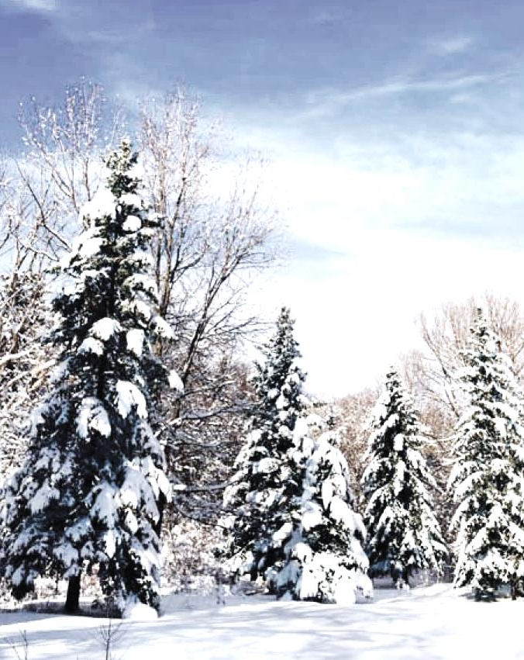
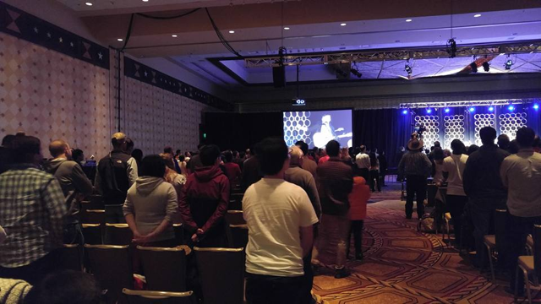
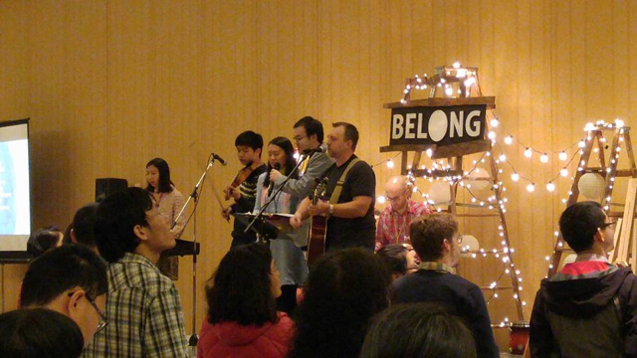
CBCGL FAMILY NEWS
WELCOME TO
CBCGL English Ministry
Praise the Lord! We have collected a pledge of $2,300.00 last Sunday and reached a total of $1,918,170.00 to date. Please continue to pray for and participate to pledge for the equipment expenditure, ask God’s blessing that we can move on to Phase II quickly after the completion of Phase I. Please issue the check to "CBCGL" with "Building Project" on the memo line for your donation.
The next baptism will be on Easter Sunday 3/27. Anyone prepares to be baptized may contact Pastor Nathan (for youth) or Pastor Wu (adult). Pastor Wu can be reached at 732-535-1772 or peterwu211@gmail.com.
English congregation has lunch service and kitchen clean up duties on Feb. 28. We will need a total of 12 volunteers: 6 for clean up and serve lunch at noon and 6 more people to clean table and sweep floor at 1:15pm. Please contact Marina Lam.
2016 Middle School Student Winter Teen Conference is next weekend. Please pray for students and coworkers.
Seeking to Transform Lives and Communities
- Opportunities and Actions, John 9:4
February 21, 2016
Call to Worship
Scripture Reading & Opening Prayer
Songs of Worship
Message
In Him, the light of men
John 1:1-14
Elder Sam Cheung
Response & Offering
Announcements
Benediction and Doxology
Sunday School: 11:30 AM
Focus on Missions
Update from Ying Xu
Mission Field: International Students, Colleges in Boston, MA
Thanks for your prayers. I was blessed to be able to spend a week with James' family and my cousin together in south Texas during the Christmas holidays. On the 27th, I attended the annual Vision conference in Austin, where over 700 students from more than 50 countries participated. Half of the student attendees were seekers. During the conference, I was moved by many amazing conversations and discussions with coworkers and students. The last night of the conference, there was a time of sharing. Some student believers shared their faith with the non-believers in their respective groups. Could you please join me in prayer that God will stir up the hearts of the non-believes, enable them to trust their lives in Jesus Christ? Below are two pictures of the conference.
Chinese Bible Church of Greater Lowell
Pastor Peter Wu, Senior Pastor | Pastor Nathan Willems, Youth
Pastor James Chung, Mandarin | Pastor Chen, Cantonese
197 Littleton Road | Chelmsford, MA 01824
978.256.3889 | english@cbcgl.org | www.cbcgl.org

